Slide 1
PROCESS FRAMEWORK FOR SOFTWARE ENGINEERING
Enhancing Software Development Practices
Presenter’s Name: Nikhil Rajendra Dhumal
Presentation Date: 05/10/2023
Notes:
Begin your presentation with a warm greeting to the audience.
Clearly state the purpose of your presentation and what the audience can expect to learn.
Briefly introduce yourself and mention your expertise or background in software engineering or related fields.
Ensure that the slide design is visually appealing and legible from a distance.
Rehearse your introduction to establish a confident and engaging start to your presentation.

Slide 2



Introduction
Significance of Software Development:
Software development is at the heart of the modern technological revolution.
It touches every aspect of our lives, from mobile apps to mission-critical systems.
The Challenges We Face:
The tech world is evolving at breakneck speed.
Software projects are becoming increasingly complex.
The demand for high-quality, efficient development is ever-growing.
Notes:
Opening Statement: Welcome to our exploration of Software Engineering Process Frameworks. In today's rapidly evolving technological landscape, software development plays a pivotal role. Let's embark on a journey to understand why.
Notes for the Presenter:
Begin with a warm and engaging greeting to capture your audience's attention.
Speak clearly and confidently to convey the significance of the topic.
Highlight the challenges faced in software development to underscore the need for process frameworks.
Conclude the slide by reiterating your presentation's objectives and the importance of the topic.
Summary:
Thank you for joining me today as we delve into the world of software development and explore the importance of process frameworks. In this introduction, we've highlighted just how significant software development has become in our lives, touching everything from our smartphones to critical infrastructure.
As the world of technology advances at an unprecedented pace, software projects are growing increasingly complex. This complexity presents us with a unique set of challenges. The demand for software that is not only high-quality but also efficient and adaptable is higher than ever before.
Today, we'll address these challenges by discussing process frameworks for software engineering. These frameworks serve as essential tools to navigate the ever-changing landscape of software development. So, let's dive in and discover how process frameworks can enhance our software development practices."
This summary should help you transition smoothly into the main discussion of process frameworks in software engineering. If you have content ready for the next slide or if you'd like assistance with any specific part of your presentation, please feel free to share it.

Slide 3

What is a Process Framework?
Definition: A process framework, in the context of software engineering, is a structured and standardized approach that defines how a software project should be planned, executed, monitored, and controlled.
Purpose: It provides a clear and organized roadmap for software development teams, outlining the steps, stages, and activities involved in the entire project lifecycle.
Structure and Guidance:
Process frameworks offer a structured path for development, ensuring that important steps aren't missed.
They serve as a guidebook, helping teams navigate complex projects with clarity.
Consistency and Quality:
By following a framework, teams maintain consistency in their processes, which can enhance the quality and reliability of the product.
It aids in setting and meeting quality standards and client expectations.
Notes:
Begin by explaining the definition and purpose of a process framework.
Emphasize how process frameworks provide structure and guidance to software development teams.
Highlight the benefits of consistency and quality that process frameworks bring to software development.
You can engage the audience by asking a rhetorical question or providing a brief real-world example to illustrate the concept further.
Summary:
In Slide 3, we delve into the essence of a process framework in software engineering. We define it as a structured and standardized approach that guides the planning, execution, monitoring, and control of software projects. The primary purpose of a process framework is to provide a clear and organized roadmap for software development teams, outlining the various steps, stages, and activities throughout the entire project lifecycle.
Furthermore, we discussed how process frameworks offer structure and guidance, ensuring that crucial steps are not overlooked. They act as a guidebook, particularly valuable when navigating complex and multifaceted projects. Additionally, we highlighted that adherence to a process framework fosters consistency in processes, ultimately enhancing the quality and reliability of the end product. It also plays a pivotal role in setting and meeting quality standards and client expectations.

Slide 4
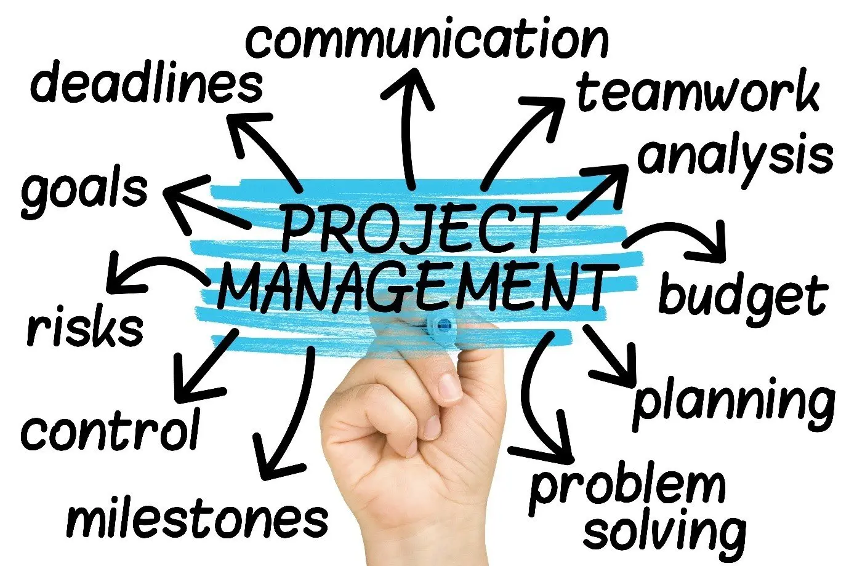
Benefits of Process Framework
Enhanced Efficiency:
Process frameworks streamline project workflows, reducing time wastage and optimizing resource utilization.
Teams work more efficiently, delivering results faster.
Improved Quality:
By adhering to standardized processes, the likelihood of errors and defects is reduced.
This leads to higher quality software and a more satisfying end-user experience.
Effective Project Management:
Frameworks provide clear project milestones and deliverables, facilitating better project tracking.
Project managers can make informed decisions, ensuring projects stay on course.
Risk Reduction:
Standardized processes help identify and mitigate risks early in the project lifecycle.
This leads to fewer surprises and a more predictable project outcome.
Notes:
Begin by explaining the key points regarding the benefits of process frameworks.
Elaborate on each benefit, providing examples or real-world scenarios where applicable.
Emphasize how process frameworks positively impact project efficiency, quality, management, and risk mitigation.
You can use anecdotes or case studies to illustrate the benefits more vividly.
Consider adding a transition sentence at the beginning of the slide to smoothly connect it with the previous content. For example, you could say, "Now that we understand what a process framework is, let's explore the significant benefits it brings to software development."
Summary: "In Slide 4, we focus on the numerous benefits of implementing a process framework in software development.
Enhanced Efficiency: Process frameworks play a crucial role in streamlining project workflows, minimizing time wastage, and optimizing the use of resources. This enhanced efficiency allows teams to work more productively, resulting in faster project delivery.
Improved Quality: Adherence to standardized processes reduces the likelihood of errors and defects. This, in turn, leads to higher quality software and a more satisfying end-user experience.
Effective Project Management: Process frameworks provide clear project milestones and deliverables, making project tracking and management more effective. Project managers can make informed decisions to ensure projects stay on course.
Risk Reduction: Standardized processes help identify and mitigate risks early in the project lifecycle, reducing surprises and making project outcomes more predictable.
These benefits collectively demonstrate the tangible advantages of incorporating process frameworks into software development practices.

Slide 5
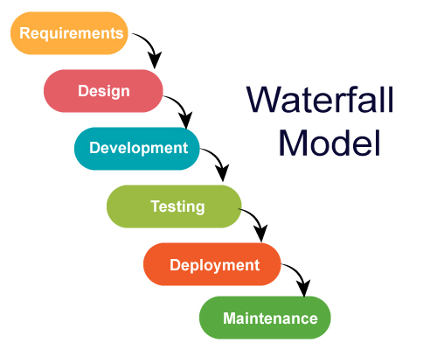
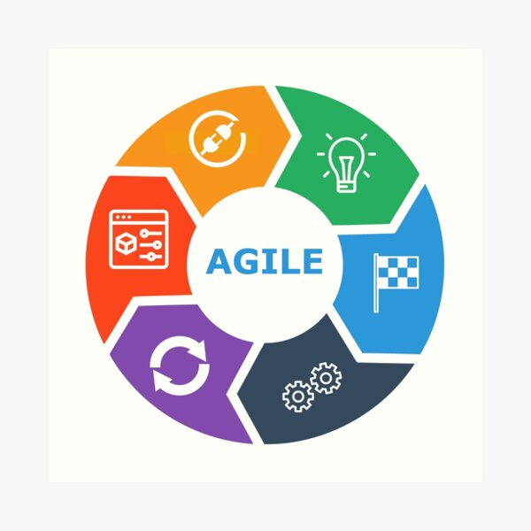
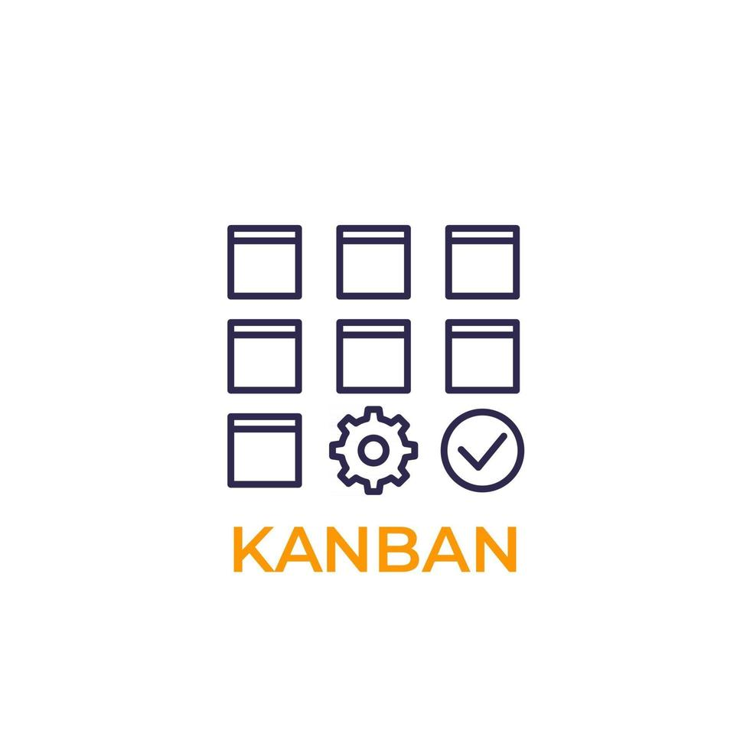
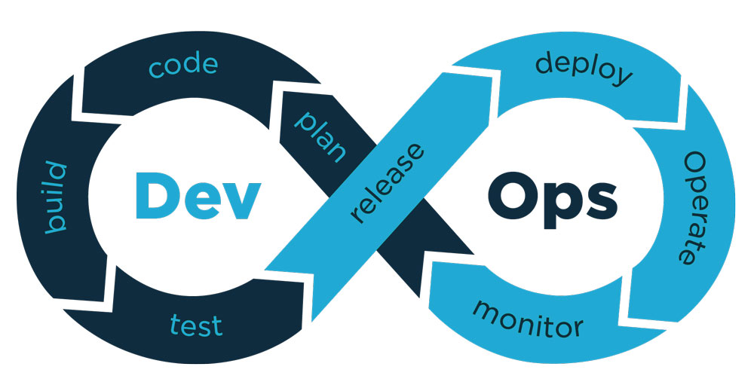
Common Process Frameworks
List of Common Frameworks:
Agile
Waterfall
Scrum
Lean
DevOps
Kanban
Notes:
Introduce the slide by explaining that you will be discussing common software development process frameworks.
Briefly describe each framework listed and mention its key characteristics or principles.
You can highlight the diversity of frameworks available and explain that different frameworks are suitable for different project types or organizational needs.
Depending on your audience's familiarity with these frameworks, you can choose to provide more or less detail about each one.
Consider adding a brief introductory sentence to provide context for the list. For example, you could say, "In the world of software development, there are various process frameworks used to guide projects. Here are some common ones:"
Summary: "In Slide 5, we introduce you to some of the common process frameworks widely used in the field of software development. These frameworks provide structured approaches to managing software projects and are tailored to different project types and requirements.
The list of common frameworks includes:
Agile
Waterfall
Scrum
Lean
DevOps
Kanban
These frameworks offer distinct methodologies, and understanding their principles and characteristics can help teams choose the most suitable approach for their specific project needs. We'll be exploring some of these frameworks in more detail in the upcoming slides.

Slide 6
Key Elements of a Process Framework
Framework Purpose: Defines the overall objectives and goals the framework aims to achieve.
Process Steps: Outlines the specific steps and activities to be followed during project execution.
Roles and Responsibilities: Identifies the roles of team members and their responsibilities within the framework.
Artifacts and Deliverables: Specifies the documents, code, or other outputs generated at each stage.
Notes:
Introduce the slide by explaining that you will be discussing the key elements that make up a process framework.
Describe each element briefly, emphasizing its importance in guiding and structuring the software development process.
You can provide examples or illustrations to clarify how these elements function within a framework.
Stress that a well-defined framework should encompass these key elements to be effective.
Consider adding a brief introductory sentence to provide context for the content. For example, you could say, "Now that we've introduced common process frameworks, let's dive into the key elements that make up these frameworks."
Summary: "In Slide 6, we explore the fundamental components that constitute a process framework in software development. Understanding these key elements is essential for effectively implementing and utilizing a framework.
Framework Purpose: This element defines the overarching objectives and goals that the framework aims to achieve. It provides a clear sense of direction for the project.
Process Steps: The process steps section outlines the specific activities and steps that need to be followed during the execution of a project. It serves as a roadmap, guiding the team through the project lifecycle.
Roles and Responsibilities: Within a process framework, roles and responsibilities are clearly defined for team members. This ensures that everyone understands their part in the project and contributes effectively.
Artifacts and Deliverables: This component specifies the documents, code, or other outputs that are generated at each stage of the project. These artifacts are essential for tracking progress and ensuring the project stays on course.
These key elements collectively form the foundation of a process framework and play a crucial role in ensuring successful project execution."

Slide 7
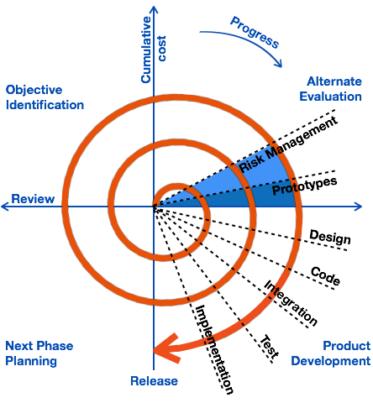
Software Development Lifecycle
Definition: The Software Development Lifecycle (SDLC) is a structured process that defines the phases and activities involved in designing, building, testing, and maintaining software systems.
Key Phases: SDLC typically includes phases such as Planning, Requirements, Design, Implementation, Testing, Deployment, and Maintenance.
Iterative Nature: Many SDLC models, like Agile and Spiral, embrace an iterative approach, allowing for flexibility and adaptation.
Notes:
Introduce the slide by explaining that you will be discussing the Software Development Lifecycle (SDLC).
Define SDLC and its purpose in software development.
Briefly describe the key phases typically found in SDLC, emphasizing that specific models may vary.
Mention the iterative nature of some SDLC models, highlighting their flexibility and adaptability.
Consider adding a brief introductory sentence to provide context for the content. For example, you could say, "Now, let's explore the Software Development Lifecycle (SDLC), a critical concept in software engineering."
Summary: "In Slide 7, we introduce the concept of the Software Development Lifecycle (SDLC), a fundamental framework that defines the stages and activities involved in designing, building, testing, and maintaining software systems.
Definition: The SDLC is a structured process that guides the entire software development journey. It provides a clear path and methodology for creating software products.
Key Phases: Typically, the SDLC comprises several key phases, including Planning, Requirements, Design, Implementation, Testing, Deployment, and Maintenance. Each phase plays a vital role in ensuring the success of a software project.
Iterative Nature: Many SDLC models, such as Agile and Spiral, embrace an iterative approach. This means that they allow for flexibility and adaptation throughout the development process, enabling teams to respond to changing requirements and feedback effectively.
Understanding the SDLC is essential for anyone involved in software development, as it forms the backbone of effective project management and delivery."

Slide 8
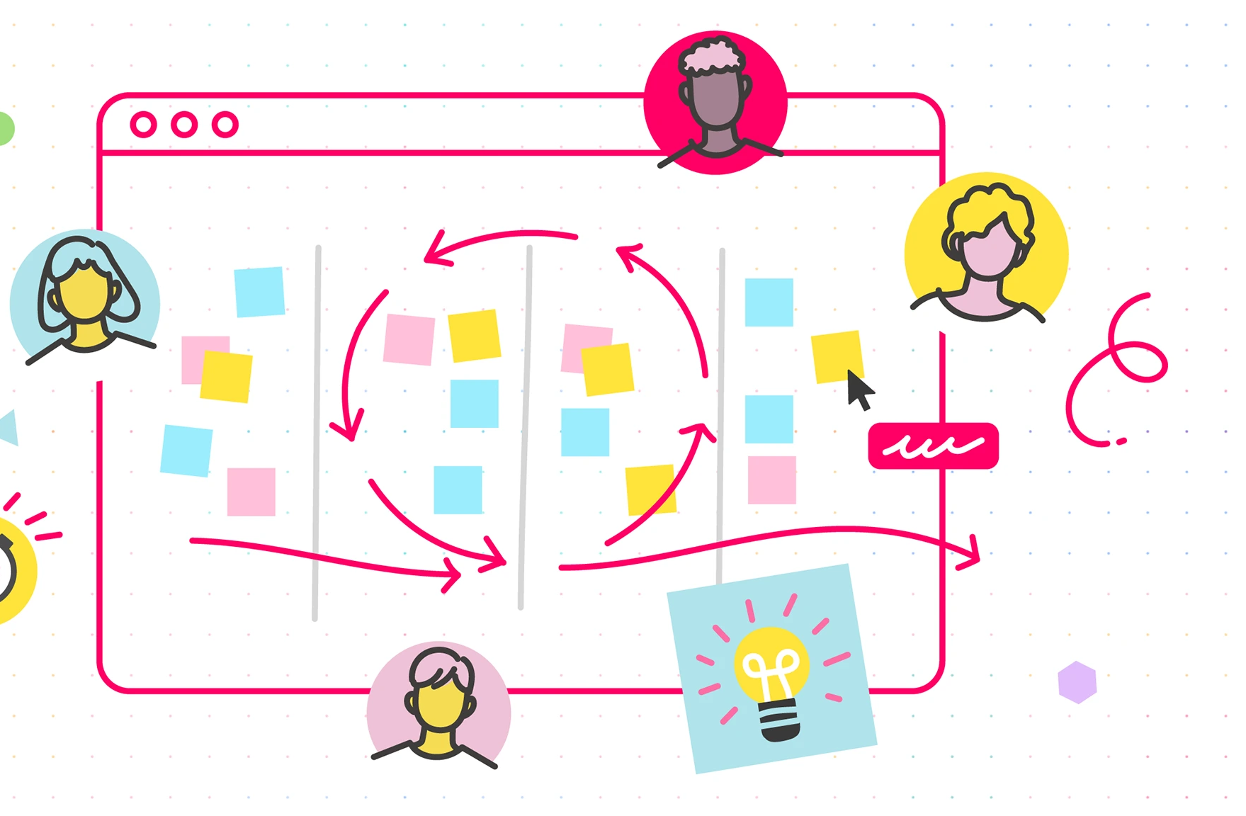
Agile Framework
Definition: Agile is a software development framework that prioritizes collaboration, flexibility, and customer feedback.
Key Principles:
Iterative Development: Work is divided into small iterations, allowing for regular assessment and adaptation.
Customer-Centric: Customer needs are at the forefront, and changes can be made quickly based on feedback.
Cross-Functional Teams: Multidisciplinary teams collaborate closely to deliver functional software.
Embracing Change: Agile welcomes changes in requirements even late in the development process.
Notes:
Begin by introducing the Agile Framework as a key approach in software development.
Explain the core principles of Agile, highlighting its emphasis on iterative development, customer-centricity, cross-functional teams, and adaptability.
Provide examples or anecdotes of successful Agile implementations to illustrate its effectiveness.
Emphasize that Agile is widely used in various industries for its ability to respond to changing project needs effectively.
Consider adding a brief introductory sentence to provide context for the content. For example, you could say, "Now, let's dive into the Agile Framework, one of the most popular and customer-centric approaches in software development."
Summary: "In Slide 8, we explore the Agile Framework, a highly popular and adaptable approach in software development.
Definition: Agile is a software development framework that places a strong emphasis on collaboration, flexibility, and customer feedback. It's known for its ability to respond to changing requirements effectively.
Key Principles:
Iterative Development: Agile divides work into small, manageable iterations, allowing for regular assessment and adaptation. This incremental approach ensures that the project remains aligned with evolving needs.
Customer-Centric: Agile is inherently customer-centric, with a focus on meeting customer needs. Changes can be made swiftly based on customer feedback, ensuring that the final product aligns with customer expectations.
Cross-Functional Teams: Agile teams are multidisciplinary and collaborate closely throughout the development process. This cross-functional approach fosters efficient communication and the delivery of functional software.
Embracing Change: One of Agile's key strengths is its ability to embrace changes in requirements, even late in the development process. This flexibility ensures that the software remains adaptable to evolving circumstances and customer needs.
The Agile Framework is renowned for its adaptability and customer-centric approach, making it a valuable methodology in the ever-changing landscape of software development."

Slide 9
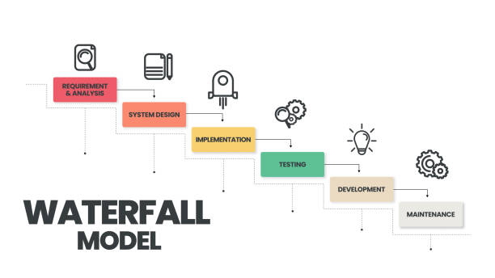
Waterfall Framework
Definition: The Waterfall Model is a traditional, linear approach to software development where each phase must be completed before the next one begins.
Key Phases:
Requirements: Gather and document project requirements comprehensively.
Design: Create detailed system and software designs based on requirements.
Implementation: Develop software based on the design specifications.
Testing: Conduct rigorous testing to detect and fix defects.
Deployment: Deploy the completed software for users.
Maintenance: Provide ongoing support, updates, and maintenance as needed.
Notes:
Introduce the Waterfall Framework as a classic, sequential approach to software development.
Describe each of the key phases, emphasizing that they occur sequentially with no overlapping.
Highlight that the Waterfall Model is well-suited for projects with stable requirements but may be less flexible in accommodating changes compared to Agile approaches.
Mention that the choice of framework depends on project characteristics and requirements.
Consider adding a brief introductory sentence to provide context for the content. For example, you could say, "Now, let's explore the Waterfall Framework, a traditional and sequential approach to software development."
Summary: "In Slide 9, we delve into the Waterfall Framework, a classical and linear approach to software development.
Definition: The Waterfall Model is a traditional, sequential approach to software development where each phase must be completed before the next one begins. It follows a step-by-step progression from requirements gathering to deployment.
Key Phases:
Requirements: The process begins with comprehensive gathering and documentation of project requirements. This phase lays the foundation for the entire project.
Design: Next comes the creation of detailed system and software designs based on the gathered requirements. This step establishes the blueprint for development.
Implementation: In the implementation phase, software is developed based on the design specifications. This phase involves coding and building the software according to the design.
Testing: Rigorous testing is conducted to detect and fix defects. This phase ensures that the software meets the specified requirements and functions as intended.
Deployment: Once testing is successful, the completed software is deployed for end-users, making it available for use.
Maintenance: The final phase involves providing ongoing support, updates, and maintenance as needed to ensure the software continues to perform effectively.
The Waterfall Framework is known for its structured and sequential approach, making it suitable for projects with well-defined requirements and limited changes."

Slide 10

Choosing the Right Framework
Assess Project Requirements:
Examine the specific needs, goals, and characteristics of your project.
Consider factors like project size, complexity, and client expectations.
Understand Team Capabilities:
Evaluate the skills and expertise of your development team.
Ensure that the chosen framework aligns with the team's strengths.
Client and Stakeholder Involvement:
Involve clients and stakeholders in the decision-making process.
Their input and expectations can influence the framework choice.
Flexibility and Adaptability:
Assess the flexibility of the framework to adapt to changing project requirements.
Consider how well it accommodates evolving needs.
Notes:
Begin by explaining the importance of selecting the right framework for a software development project.
Elaborate on each key point, providing insights on how to assess project requirements, team capabilities, and the role of clients and stakeholders.
Emphasize the need for flexibility and adaptability in choosing a framework to accommodate changes during the project.
Share examples or anecdotes to illustrate the decision-making process when selecting a framework.
Consider adding a brief introductory sentence to provide context for the content. For example, you could say, "Now, let's explore the essential considerations when choosing the right framework for your software development project."
Summary: "In Slide 10, we delve into the critical task of selecting the appropriate framework for your software development project.
Assess Project Requirements: The first step is to thoroughly examine the specific needs, goals, and characteristics of your project. Take into account factors like project size, complexity, and client expectations. This in-depth understanding of your project's unique requirements is the foundation for selecting the most suitable framework.
Understand Team Capabilities: Next, evaluate the skills and expertise of your development team. It's crucial to ensure that the chosen framework aligns with your team's strengths and capabilities. This alignment significantly contributes to the project's success.
Client and Stakeholder Involvement: Involve your clients and stakeholders in the decision-making process. Their input and expectations can have a substantial influence on the framework choice. Collaboration and transparency in this regard are key to aligning the project with client needs.
Flexibility and Adaptability: Finally, assess the flexibility of the framework to adapt to changing project requirements. Consider how well it accommodates evolving needs. This adaptability is particularly critical in today's dynamic software development landscape.
Selecting the right framework is a pivotal decision that significantly impacts the success of your project. By following these guidelines, you can make a well-informed choice that aligns with your project's goals and requirements."

Slide 11
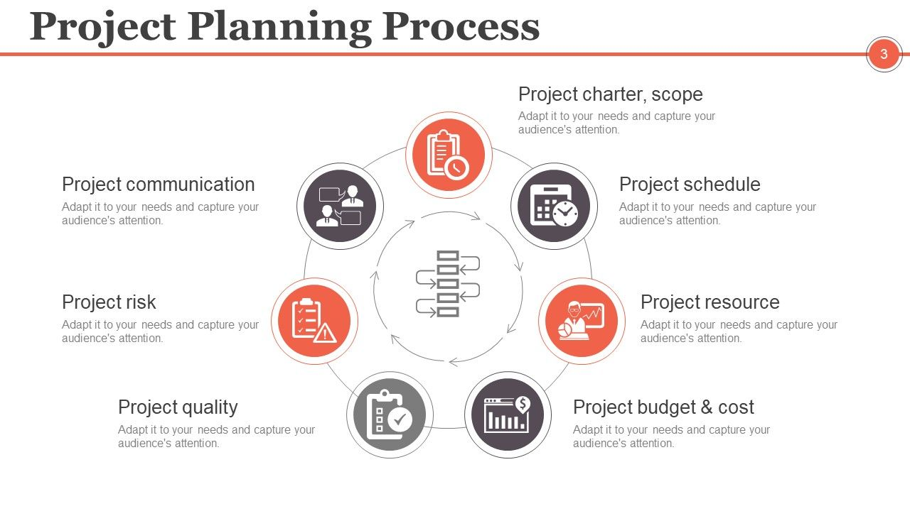
Implementing a Process Framework
Selecting the Framework:
Choose a suitable software development process framework based on project requirements.
Team Training:
Provide training and resources to ensure the team is proficient in the selected framework.
This step is crucial for successful implementation.
Project Planning:
Create a detailed project plan that aligns with the framework's principles.
Include milestones, timelines, and responsibilities.
Continuous Monitoring:
Establish a system for ongoing project monitoring and progress tracking.
Ensure that the project remains aligned with the framework.
Notes:
Begin by explaining the importance of effectively implementing the chosen framework in a software development project.
Elaborate on each key step, emphasizing the need for team training, detailed project planning, continuous monitoring, and adaptation.
Share best practices for each step and highlight how they contribute to successful framework implementation.
Mention that adaptability and feedback are crucial for fine-tuning processes throughout the project.
Consider adding a brief introductory sentence to provide context for the content. For example, you could say, "Now, let's discuss the essential steps for implementing a process framework effectively."
Summary: "In Slide 11, we explore the key steps involved in implementing a process framework for software development.
Selecting the Framework: The first step is to choose a suitable software development process framework based on your project requirements. This decision forms the foundation of the implementation process and should align with your project's unique needs.
Team Training: Once the framework is selected, it's crucial to provide training and resources to ensure that your team becomes proficient in the chosen framework. This step is essential for the successful implementation of the framework and ensures that team members are on the same page.
Project Planning: With the framework chosen and the team trained, the next step is to create a detailed project plan that aligns with the principles of the framework. This plan should include milestones, timelines, and clearly defined responsibilities, providing a roadmap for project execution.
Continuous Monitoring: To ensure the project remains aligned with the chosen framework, establish a system for continuous project monitoring and progress tracking. Regular assessments and adjustments are critical to maintaining framework adherence and achieving project success.
Effective implementation of a process framework is vital for streamlining your software development processes and optimizing project outcomes."

Slide 12
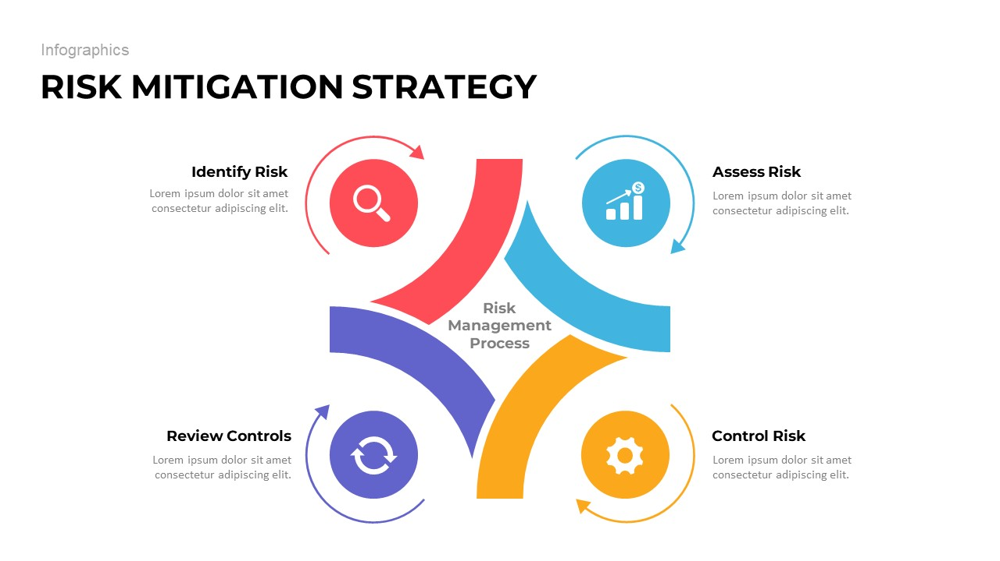
Challenges and Pitfalls
Common Challenges: Highlight some common challenges that organizations may face when implementing software development process frameworks.
Pitfalls to Avoid: Discuss potential pitfalls or mistakes that can hinder the effective use of a framework.
Mitigation Strategies: Offer strategies or recommendations for mitigating these challenges and avoiding pitfalls.
Notes:
Begin by explaining that while software development process frameworks offer many benefits, they also come with challenges and potential pitfalls.
Highlight some common challenges that organizations may encounter when implementing frameworks and discuss why they can be problematic.
Offer practical strategies and recommendations for mitigating these challenges and avoiding common pitfalls.
Encourage the audience to consider these insights when implementing frameworks in their own projects to ensure smoother adoption and successful outcomes.
Consider adding a brief introductory sentence to provide context for the content. For example, you could say, "Now, let's explore some of the common challenges and potential pitfalls organizations may encounter when implementing software development process frameworks."
Summary: "In Slide 12, we address the challenges and pitfalls that organizations may encounter during the implementation of software development process frameworks.
Common Challenges: Implementing a process framework can present various challenges, including resistance to change, difficulties in adapting to new processes, and potential disruptions to ongoing projects. It's important to recognize and address these challenges proactively.
Pitfalls to Avoid: There are several potential pitfalls that can hinder the effective use of a framework. These may include rigid adherence without flexibility, overlooking team dynamics, and underestimating the importance of ongoing training and support.
Mitigation Strategies: To navigate these challenges and avoid pitfalls, organizations should have mitigation strategies in place. These may include comprehensive change management plans to address resistance, a focus on team collaboration and communication, and ongoing training and support programs to keep the team proficient in the chosen framework.
By understanding these common challenges and pitfalls and implementing effective mitigation strategies, organizations can enhance the successful implementation and utilization of software development process frameworks."

Slide 13
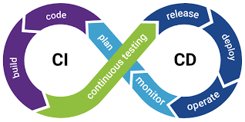
Best Practices
List of Software Development Best Practices:
Continuous Integration and Continuous Deployment (CI/CD)
Regular Code Reviews
Automated Testing
Agile Retrospectives
Notes:
Begin by explaining the importance of adopting best practices in software development, especially when working within a framework.
For each best practice listed, briefly describe its significance and how it contributes to efficient and high-quality software development.
Encourage your audience to consider integrating these practices into their workflows for improved outcomes.
Share examples or success stories related to the implementation of these best practices if applicable.
Consider adding a brief introductory sentence to provide context for the content. For example, you could say, "Now, let's explore some of the best practices in software development that can enhance the effectiveness of your chosen framework."
Summary: "In Slide 13, we highlight some of the best practices in software development that can significantly contribute to the effectiveness of your chosen framework.
List of Software Development Best Practices:
Continuous Integration and Continuous Deployment (CI/CD): CI/CD practices involve the frequent integration of code changes and the automated deployment of software. This ensures that your software is always up-to-date, stable, and ready for release.
Regular Code Reviews: Code reviews involve the examination of code by team members to identify issues and ensure code quality. Regular code reviews promote collaboration, code improvement, and error prevention.
Automated Testing: Automated testing involves the use of automated tools and scripts to test software functionality. It helps identify defects early in the development process, ensuring a higher quality end product.
Agile Retrospectives: Agile retrospectives are meetings held at the end of each development iteration to reflect on the team's performance and identify areas for improvement. They foster continuous learning and process enhancement.
These best practices are valuable tools that can be integrated into your software development processes, aligning with your chosen framework and contributing to the success of your projects."

Slide 14

Conclusion
Key Takeaways:
Software development process frameworks streamline project management.
Consider project requirements, team capabilities, and adaptability when choosing a framework.
Challenges exist but can be mitigated with best practices.
The Importance of Frameworks: Frameworks enhance collaboration, efficiency, and project success in modern software engineering.
Consider implementing suitable frameworks in your projects.
Embrace software development best practices for better outcomes.
Notes:
Use this slide to summarize the presentation's main points and key takeaways concisely.
Reiterate the central message about the importance of software development process frameworks in modern software engineering.
Encourage your audience to take action by considering the implementation of suitable frameworks and the adoption of best practices in their projects.
Thank your audience for their participation and open the floor for questions and discussions during the Q&A session if applicable.
Consider adding a brief introductory sentence to provide context for the content. For example, you could say, "In conclusion, let's recap the key takeaways and emphasize the importance of software development process frameworks."
Summary: "In Slide 14, we bring our presentation to a close by summarizing the key takeaways and emphasizing the significance of software development process frameworks.
Key Takeaways:
Software development process frameworks are powerful tools that streamline project management and enhance project success.
When selecting a framework, consider project requirements, team capabilities, and adaptability.
Challenges in implementation can be effectively mitigated by following best practices.
The Importance of Frameworks: Frameworks play a vital role in modern software engineering by promoting collaboration, efficiency, and overall project success.
Closing Thoughts: We encourage you to consider implementing suitable frameworks in your software development projects. By embracing these frameworks and incorporating software development best practices, you can achieve better outcomes, streamline your processes, and contribute to the success of your projects.
Thank you for your attention and engagement throughout this presentation. We hope you find the insights and knowledge shared here valuable in your journey of software development."

